Slide 1
FUNCTION ANALYSYS
PYTHON
ALBERTO / BURGOS
LUCIA / BURGOS
ALEXANDRA / NHL STENDEN
LAKINI / HAMK

Slide 2
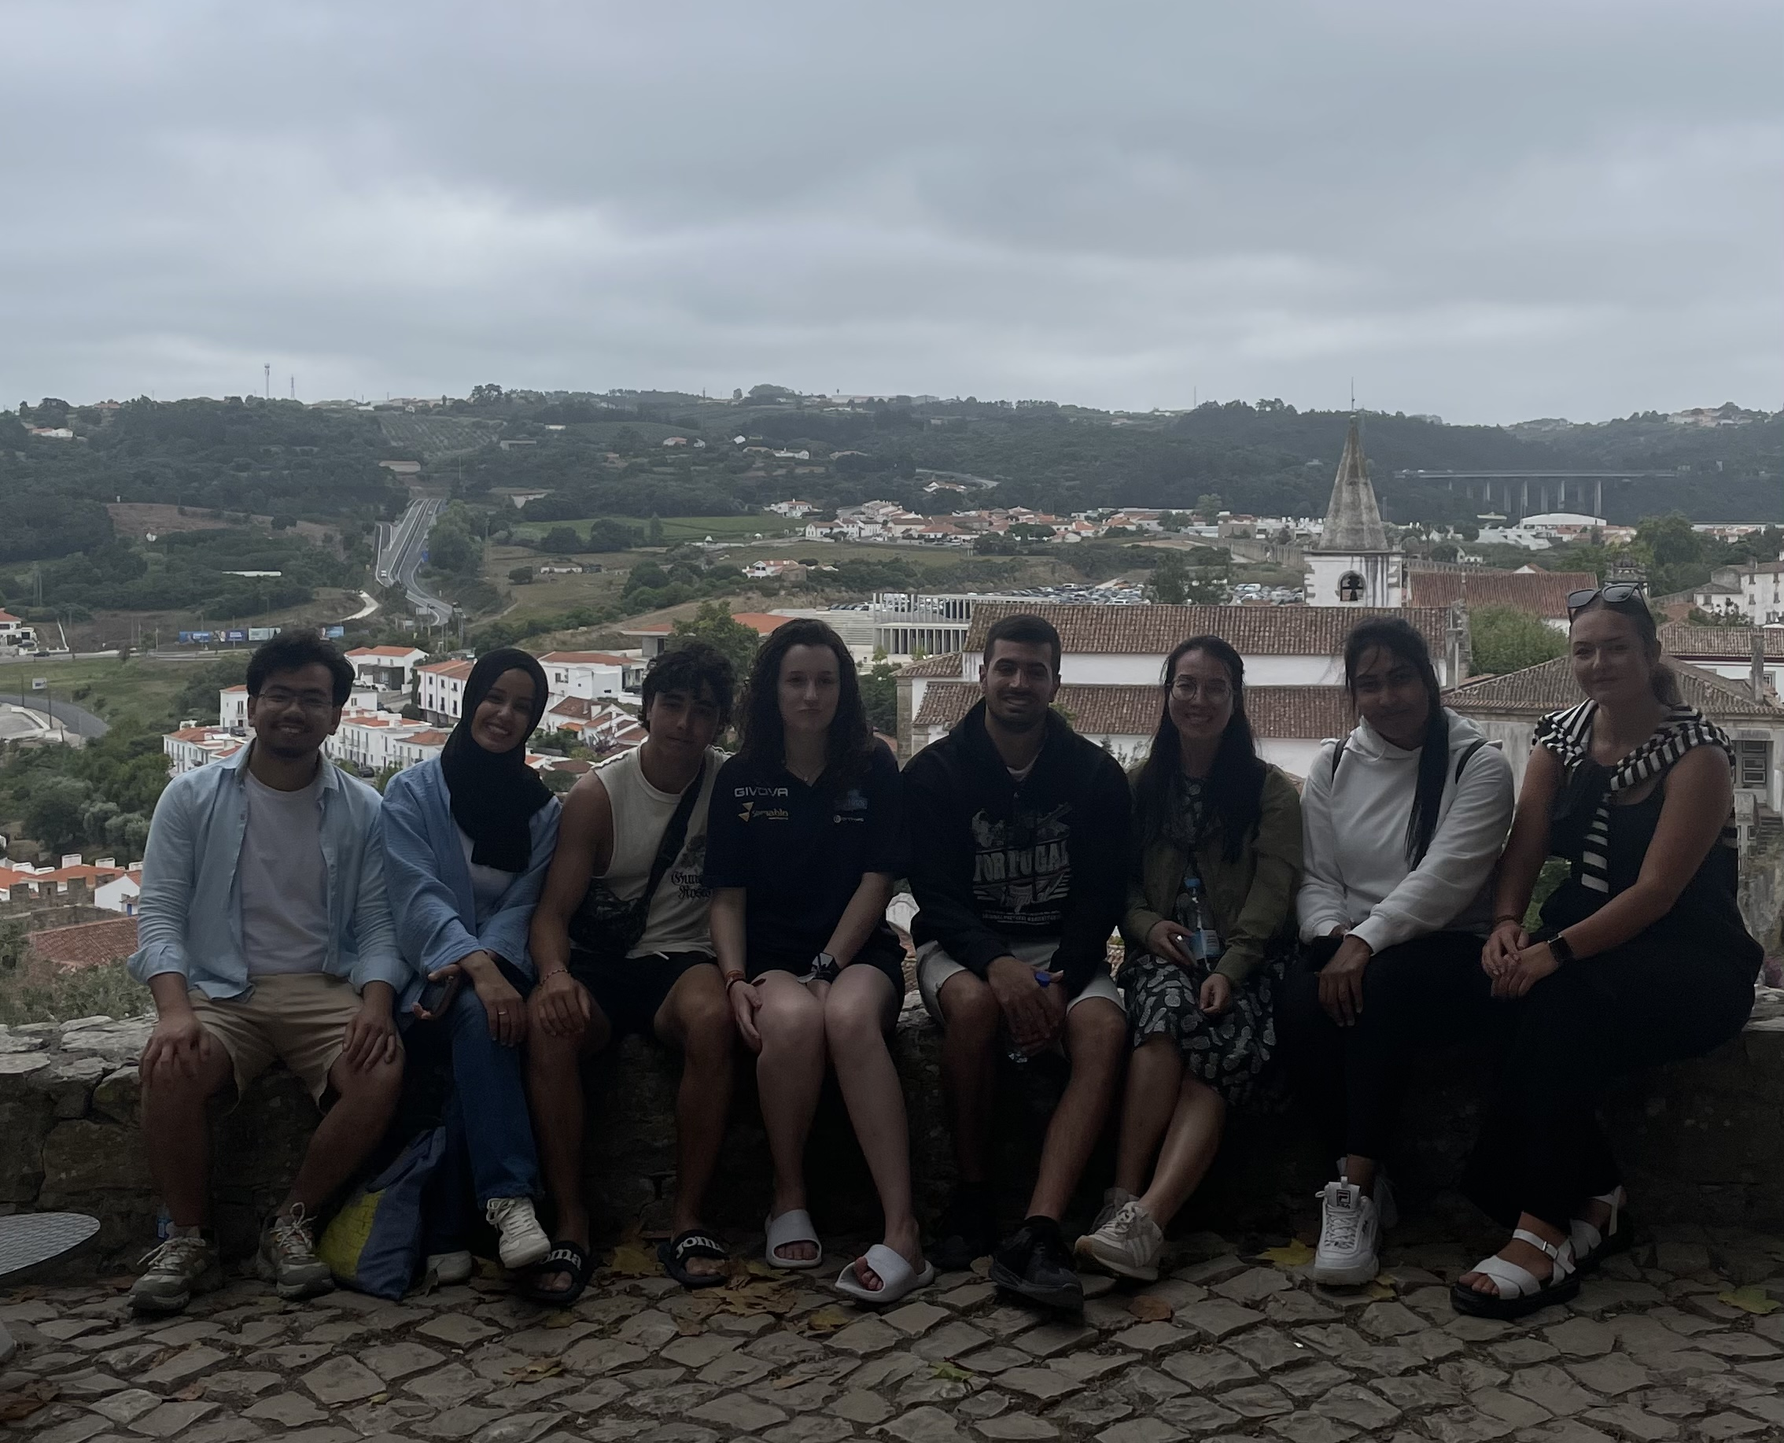
INTRODUCTION
ALBERTO / BURGOS
PYTHON
📍SPAIN
📚COMPUTER SCIENCE
LUCIA / BURGOS
📍SPAIN
📚COMPUTER SCIENCE
LAKINI / HAMK
📍SRI LANKA
📚 ICT BIOECONOMY
ALEXANDRA / NHL STENDEN
📍SLOVAKIA
📚COMMUNICATION AND MULTIMEDIA DESIGN

Slide 3
MOTIVATION
PYTHON
DURING THIS SAP WE HAD THE OPPORTUNITY TO LEARN NEW METHODS IN PYTHON AND WITH THIS PROJECT WE GOT THE CHANCE TO APPLY THEM OURSELVES.
WE CHOSE THIS PROJECT BECAUSE WE ALREADY HAVE THE KNOWLEDGE TO ANALYSE THE FUNCTION MANUALLY, HOWEVER WE WANTED TO DEVELOP PROGRAM WHICH WOULD HELP THE USER ANALYSE THE FUNCTION QUICKLY AND EFFICENTLY.

Slide 4

PROJECT IDEA
PYTHON
USING NUMERICAL METHODS TO MAKE ANALYSYS OF ANY FUNCTION IN ORDER TO APPLY THE RESULTS IN OTHER ENGENEERING APPLICATIONS

Slide 5
CONCEPT
PYTHON
USER WOULD ENTER THE FUNCTION TO ANALYSE
CODE GENERATES DIFFERENT ANSWERS WITH THE IMPORTANT POINTS OF THE FUNCTION (ASYMPTOTES, MONOTONY, CURVATURE ETC.)
THE FUNCTION WILL BE PLOTTED TO IMPROVE THE VISUALISATION OF SPECIFIC FUNCTION

Slide 6
TASKS DIVISION
ALBERTO
LUCIA
PROJECT IDEA
CODING
EXPANDING FEATURES
CODING
PYTHON
LAKINI
ALEXANDRA
PRESENTATION
CODING
PRESENTATION / VISUALISATION
CODING

Slide 7
CODE

Slide 8
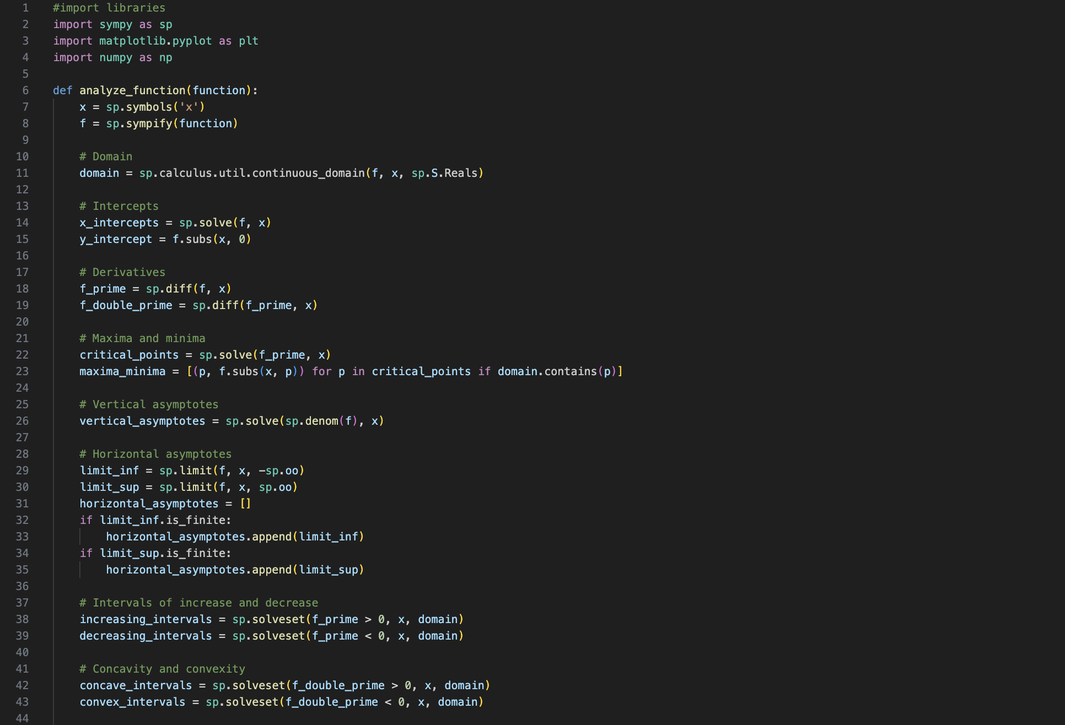

Slide 9
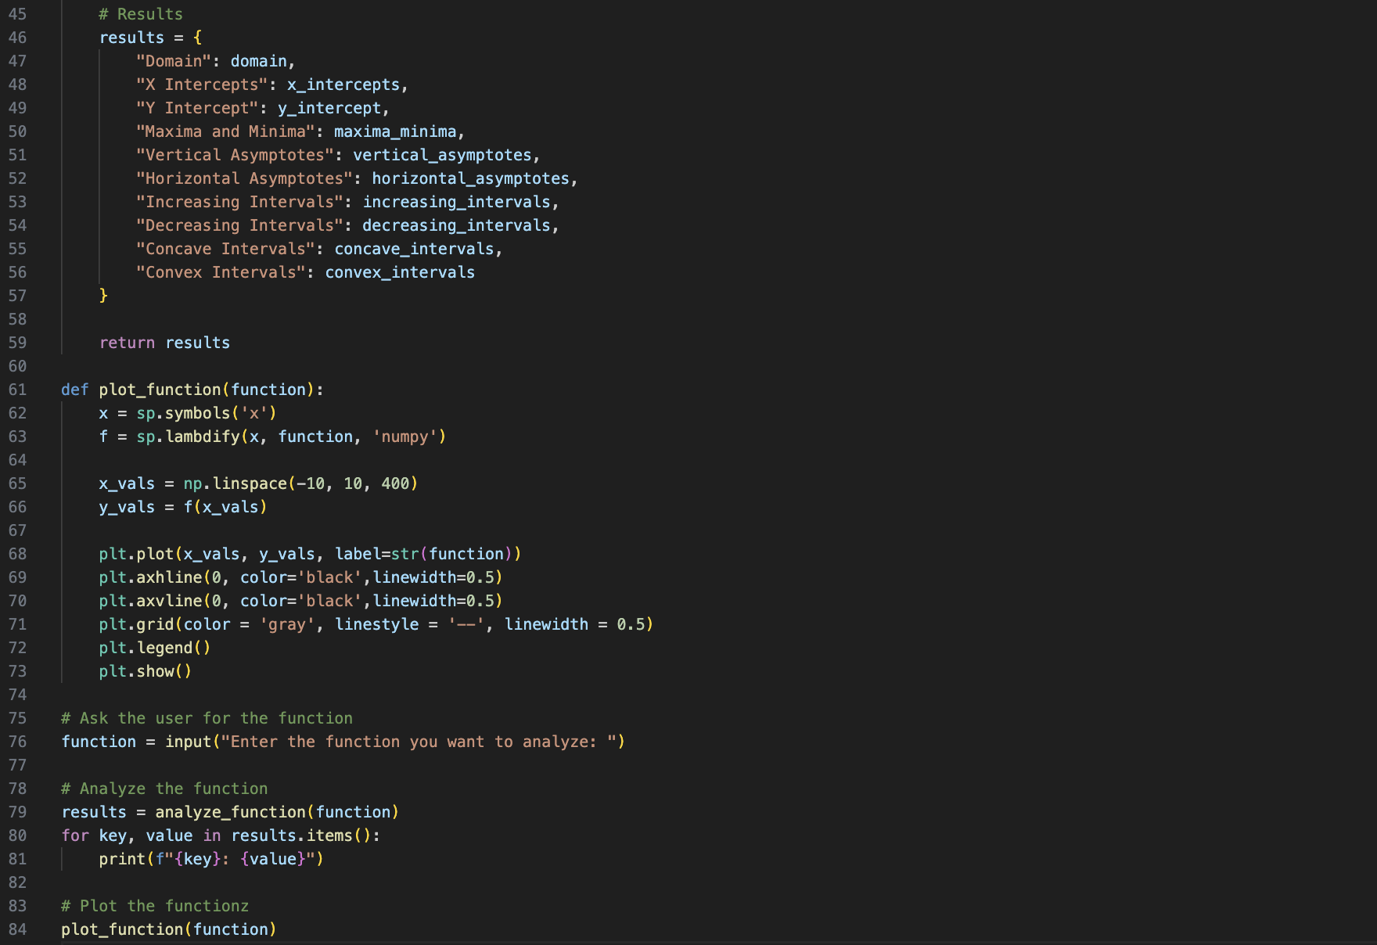


Slide 10
DEMONSTRATION

Slide 11
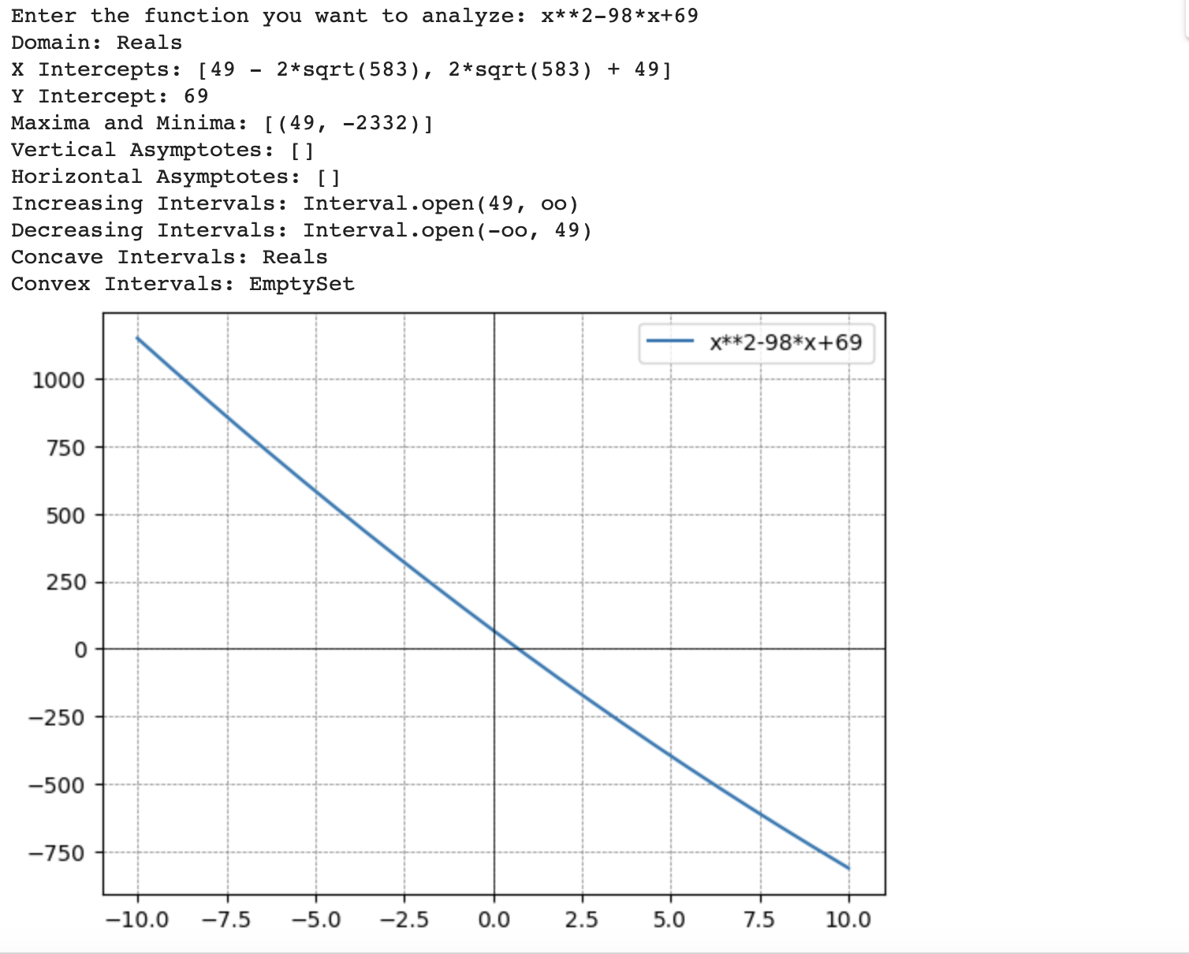

Slide 12
Conclusion
INITIALLY, WE STARTED PROGRAMMING THE CODE WITHOUT USING SIMPY, HOWEVER WE REALISED, THAT USING THIS LIBRARY WILL BE MORE EFFICIENT.
USING TKINTER LIBRARY FOR PLOTTING IS VERY USEFUL BECAUSE IT ALREADY HAS THE TOOLS FOR USER TO INTERACT WITH THE FUNCTION.

Slide 13
FUNCTION ANALYSYS
PYTHON
ALBERTO / BURGOS
LUCIA / BURGOS
ALEXANDRA / NHL STENDEN
LAKINI / HAMK
THANK YOU!

